Slide 1
SUPPORTING OUR STUDENTS & FAMILIES
Inland Leaders
Charter Schools
1-18-2017

Slide 2
ILCS LCAP PROCESS
https://www.youtube.com/watch?v=XCJMif4DBQk

Slide 3
HOW THE LOCAL CONTROL FUNDING FORMULA (LCFF) WORKS
In 2013, California dramatically reformed the way it funds our public schools. LCFF established a funding system that provides school districts with base funding and additional funds based on how many low-income students, English learners, and foster youth they serve.
BASE
GRANTS
SUPPLEMENTAL
GRANTS
CONCENTRATION
GRANTS
Every student generates a base grant, which funds basic educational costs, such as teacher salaries, retirement costs, instructional materials, etc.
Every student who is low-income, learning English, or in foster care generates 20% more funding above the base grant.
These funds must be spent on increasing and improving services for these high-need student groups in order to improve their achievement.
In districts where at least 55% of students are high-need, those high-need students above the 55% enrollment threshold generate an extra 50% of the base grant.
These funds must also be spent to increase or improve services for high-need students in order to improve their achievement.

Slide 4
THE TIMEFRAME TO DEVELOP THE LCAP
Late Summer-Fall 2016
Winter 2016
Spring 2016
Spring 2016
July 1, 2016
October 8, 2016
District engages the community to solicit input on the LCAP.
District and community assess student needs.
Suggested
District creates first draft of plan, incorporating community input.
Suggested
District presents proposed plan to parent advisory committees for feedback and input.
Suggested
District responds in writing to feedback from parent advisory committees and incorporates feedback into plan.
Suggested
School board adopts plan by July 1st in a public hearing.
Required by Statute
County office of education must approve district LCAPs by October 8th.
Required by Statute

Slide 5
THE LOCAL CONTROL & ACCOUNTABILITY PLAN (LCAPS)
All school districts must adopt a Local Control & Accountability Plan (LCAP), a 3-year plan for how districts will use state funds to serve all students.
Each district’s LCAP must include the following:
Goals
Actions
Related expenditures
LCAPs must include services that target each major student subgroup, including:
Racial/ethnic subgroups
Low-income students
English learners
Students with disabilities
Foster youth
Homeless youth
LCAPs must address the
8 State Priorities*:
Basic Services
Implementation of standards
Parental engagement
Student achievement
Student engagement
School climate
Access to courses
Other student outcomes

Slide 6
ILCS LCAP PROCESS
ILCS Board
LCAP Adoption
Monthly meetings
Finance Committee
(Priorities budgeted)
Monthly mtgs
Parent Advisory Committees
Monthly mtgs
Parent Surveys
Student data
School Leadership Team
Weekly mtgs
Staff Surveys
Sub group data
Student Data
Management
Team
Bi-monthly mtgs
Student data
Student surveys
City/ community

Slide 7
OVERVIEW OF OUR DISTRICT
# of Students
# of Staff
# of Students by Race/Ethnicity
# of Students by Subgroup
Total students:
954
Attendance over the years:
2007: 98.2%
2016: 95.0-96%
Support Staff: 41
Core Teachers: 39
Other teachers:
5
Indep study teachers: 3
Sped teachers: 4
Administrators: 3.5
Latino: 231
African American/ Black: 12
Asian:10
White: 704
Other: 9
Low Income:226
English
Learners: 43
Pacers: 44-50
SPED: 91
Homeless/Foster:23
Unduplicated or High Needs:253

Slide 8
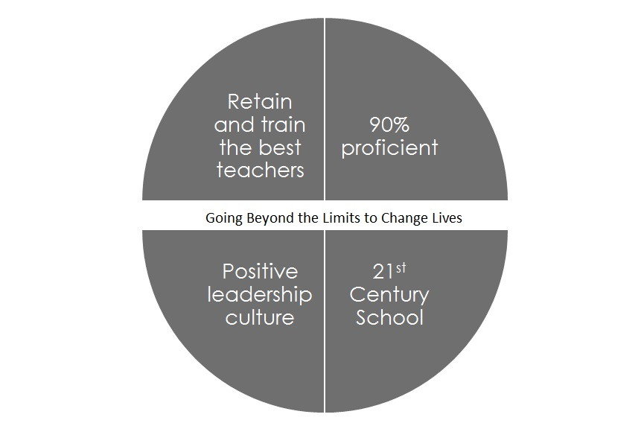
Our current LCAP goals

Slide 9
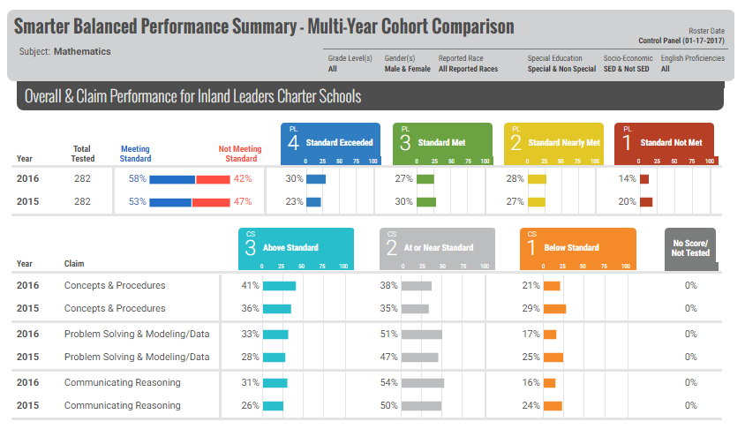
OUR DISTRICT’S STUDENT ACHIEVEMENT- Math

Slide 10
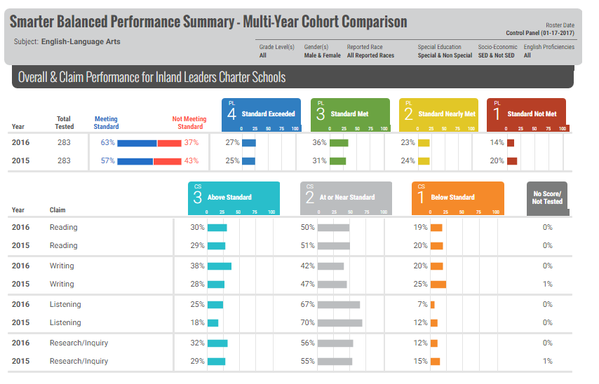
OUR DISTRICT’S STUDENT ACHIEVEMENT- ELA

Slide 11
Issues already observed this year
Attendance levels are worse than previous years
A general sense of disconnect with parents versus previous years. Many parents missing meetings and not attending events.
Middle school is experiencing a drop in student enrollment and some students leaving in 6th grade for other middle school programs.
Higher population of students that are in need of educational support enrolling.
Increase in English Language students
Increase in health related conditions such as life-threatening allergies.
Increases in behavioral issues with newly enrolled students.
Achievement gaps between students who have been at ILCS for 3 years or more vs new students who have been here less than 2 years.
Overall student achievement has not grown in any significant manner over the last year.
Students do not seem as motivated as in previous years to PACE, accelerate, go beyond the limits for science fair, leadership fair and other activities that require higher level work and dedication.

Slide 12
Break out sessions
Questions for discussion:
Essential question: What actions/services are going to support our student’s success based on current data?
What is the data telling us?
What can we as a school do to improve student success?

Slide 13
THANK YOU!

